Slide 1



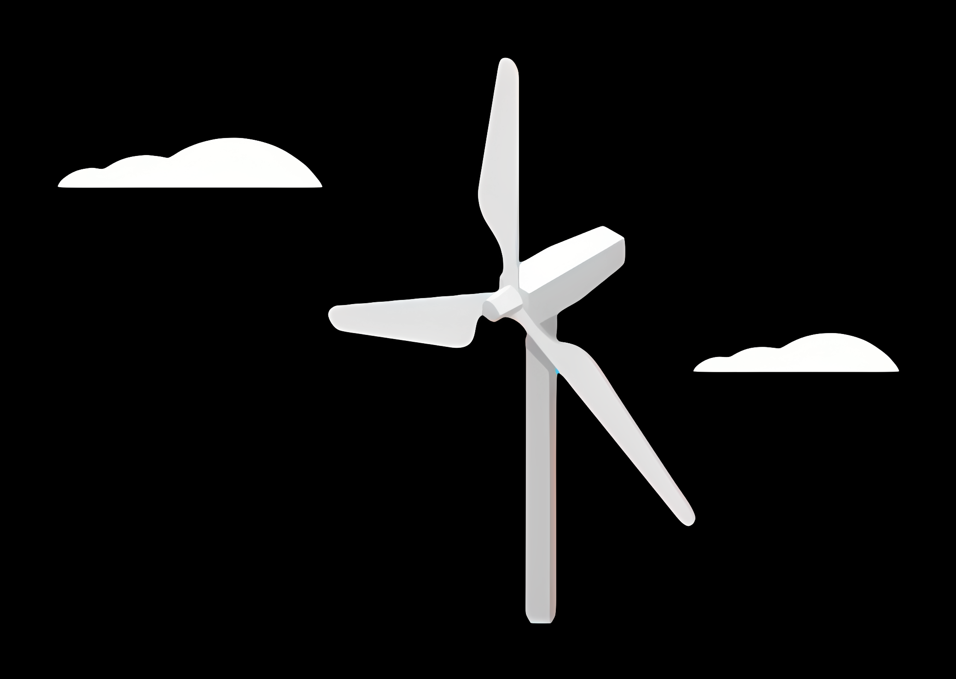
Weekly Report: Rotor Blade Structures
Week: 01
Date: 23/09/2025
Supervisor: Prof. Dr. Laurence Alhrshy
Group members: Bhima Masare, Dongsuk Kim, Anudeep Allanki, Mithun Shetty

Slide 2
Steps Planned during the
Project Phase
Reference –
5 MW/61.5m Wind Turbine Blade Reference Model by Brian R. Resor, Sandia National Laboratories, California, USA

Slide 3
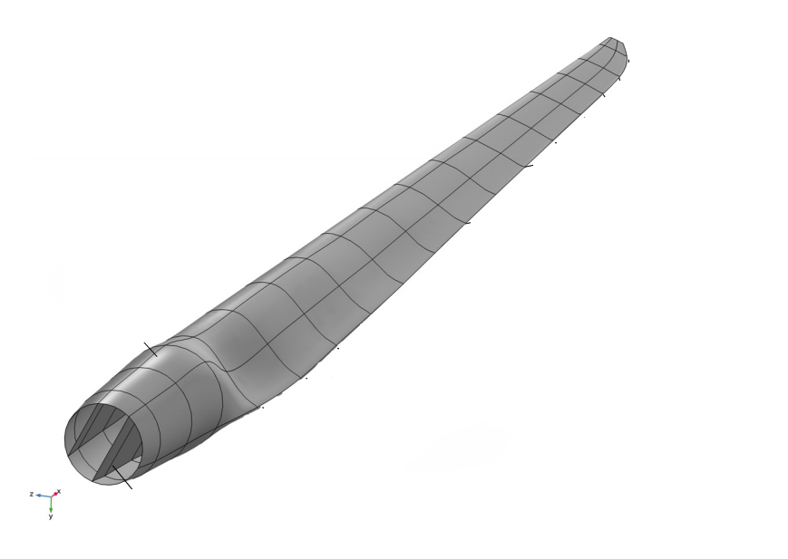
Step 1 - Define Blade Geometry
Use existing models (i.e. Brian Resor 5MW/61.5m, NREL 5MW) as reference models
Incorporate Air foil shapes, chord distribution, and blade length with help of Team Blade Aerodynamics
Adjust tip and root geometries considering structural requirements from other Teams
Ensure compatibility with manufacturing constraints with the current Industrial Standards

Slide 4
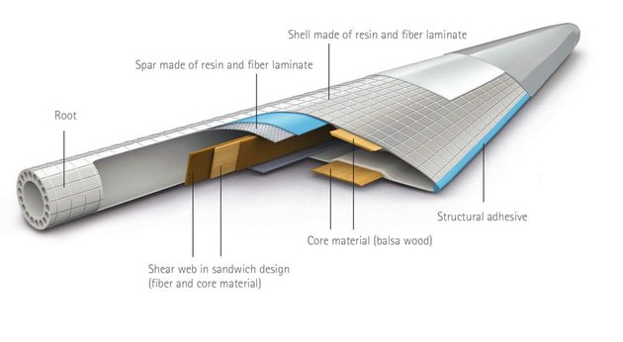
Step 2 – Material Selection
Choose materials based on strength-to-weight ratio by analysing using Softwares
Use material properties similar to those in proven models
Determine material layup strategies for skins, shear webs, spar caps
Incorporate safety factors as per IEC standards

Slide 5
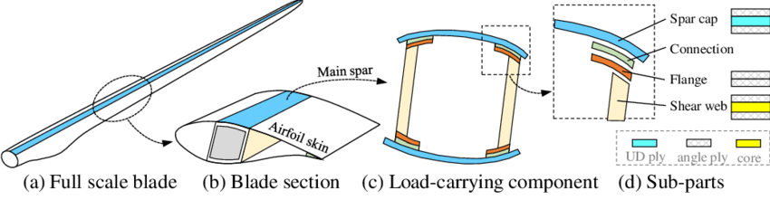
Step 3 – Structural Layout & Component Design
Design skin layups for aerodynamic surfaces
Configure shear webs and spar caps for load transfer
Optimize thickness and placement to resist buckling and fatigue
Define root hardware and connection details

Slide 6
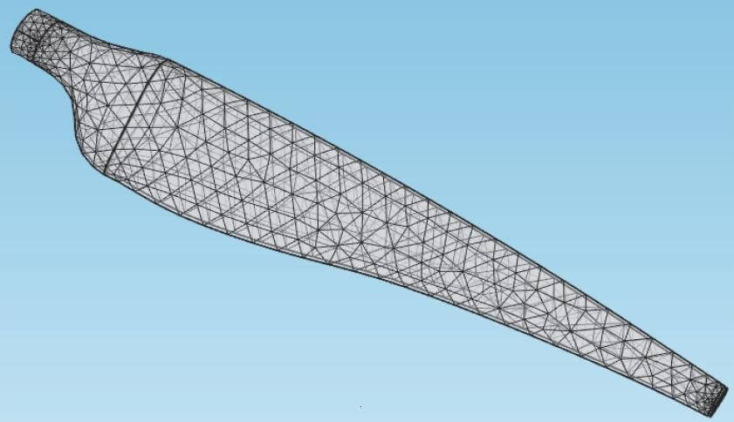
Step 4 – Finite Element Modelling
Develop detailed cross-sectional models of blade segments
Perform modal and static analyses
Validate structural integrity under expected loads
Use tools like NuMAD and ANSYS

Slide 7
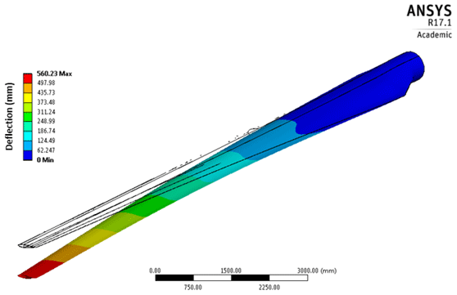
Step 5 – Load Analysis & Simulation
Apply design load cases based on IEC standards
Simulate extreme and normal operating conditions
Evaluate fatigue life, buckling safety, ultimate strength
Iteratively refine layup and design based on results

Slide 8

Step 6 – Performance Verification & Optimization
Check critical deflections and natural frequencies
Ensure tower clearance and safety margins
Adjust material distribution and structural elements
Confirm compliance with safety and durability criteria

Slide 9
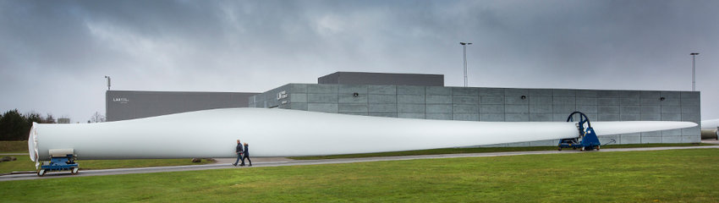
Step 7 – Final Design & Documentation
Compile detailed structural drawings and layups
Prepare analysis reports and validation results
Collaborate with manufacturing for feasibility
Prepare for further aerodynamic and control validations

Slide 10
Bibliography
Definition of a 5 MW/61.5m Wind Turbine Blade Reference Model by Brian R. Resor, Sandia National Laboratories, California, USA
Definition of a 5 MW Reference Wind Turbine for Offshore System Development, J. Jonkman, S. Butterfield, W. Musial, and G. Scott, National Renewable Energy Laboratory, USA

